Slide 1
How to Compute with PDGs:
Inference, Inconsistency Measurement, and the Close Relationship Between the Two
Oliver Richardson
based on joint work with Joe Halpern and Chris De Sa

Slide 2
Inconsistency Calculation
Exponential Conic Programming
PDG Inference
legend
Turing/Cook reduction
(polynomial time & subroutine calls)
Karp reduction in polynomial time, assuming bounded treewidth

Slide 3





Inconsistency Calculation
find min $y^{∗}$
Exponential Conic Programming
$$f(x)$$
$$y^{∗}$$
PDG Inference
$$x^{∗}$$
find argmin $x^{∗}$

Slide 4
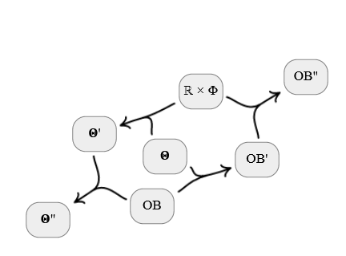
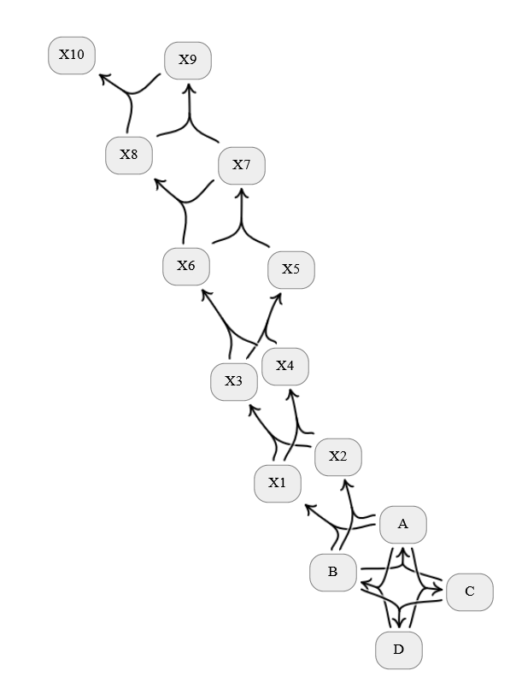
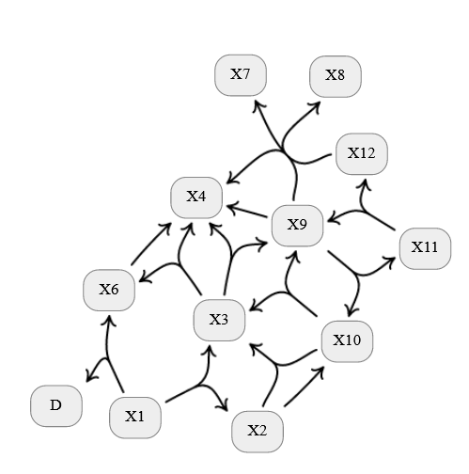
PDGs: probabilistic information of any shape

Slide 5
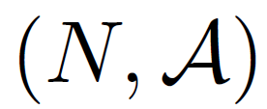


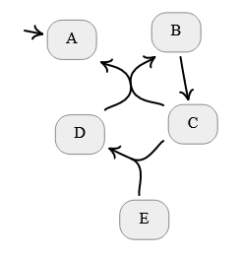

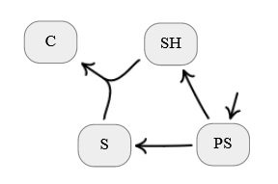
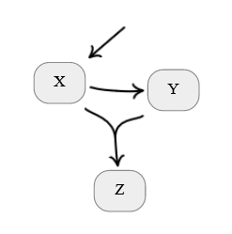


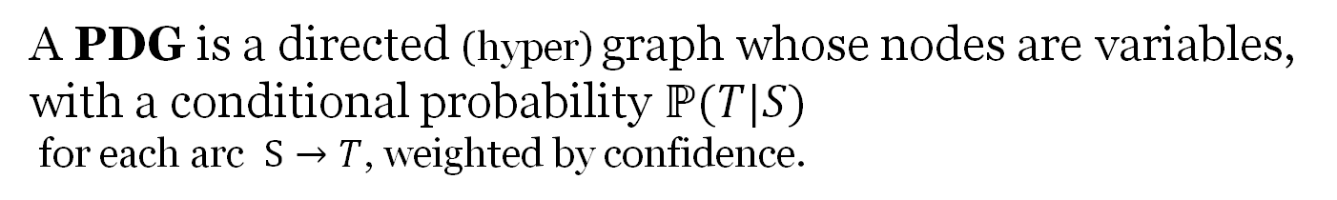

A directed hypergraph
set of hyperarcs;
each
has
set of nodes
sources
( it doesn’t matter much since hypergraphs can be compiled to graphs, but hypergraphs are more natural to think about )
and targets
.
A PDG is a directed (hyper) graph whose nodes are variables, with a conditional probability ℙ$(T|S)$
for each arc $S→T$, weighted by confidence.
P(X)
Q(X)
Bayesian Networks
<0>
(0.7)
(0.2)
Conflicting Beliefs
<statistical distances>
Variational Autoencoders
<the ELBO>
P(X)
P(Y|X)
P(Z|X,Y)

Slide 6


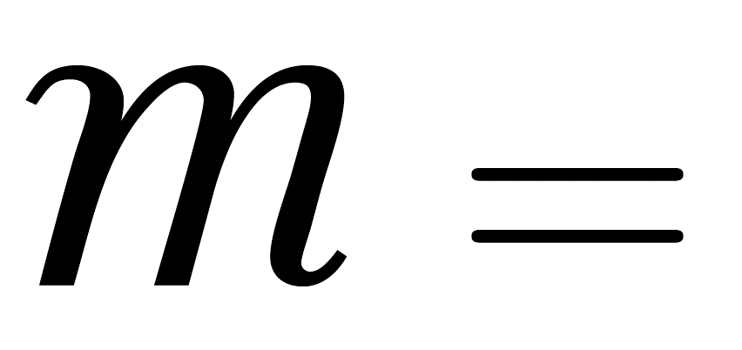

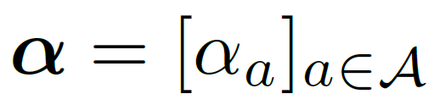


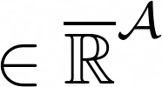
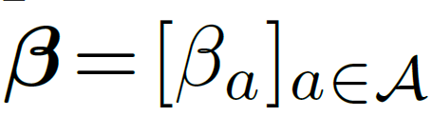




PDGs, more formally
directed hypergraph
interpret as
variables & cpds
“confidence”
weights on arcs
set of all variables
Each arc
is associated with a conditional probability
Variables
take on values
;
write
for the set of distributions over X.

Slide 7
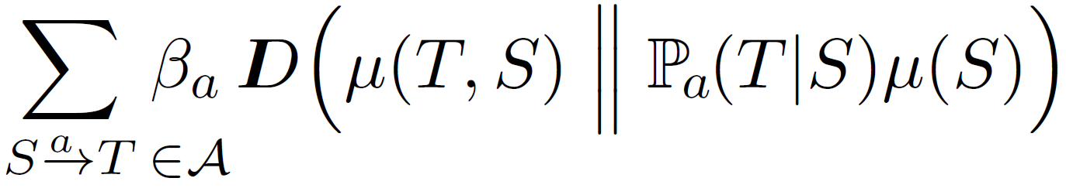
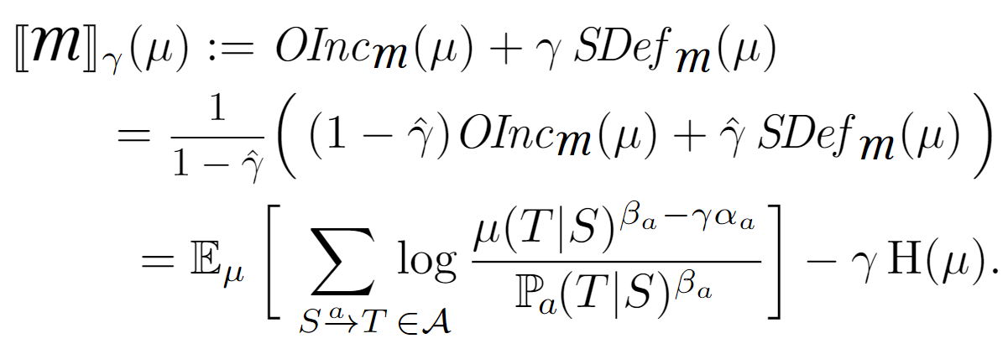


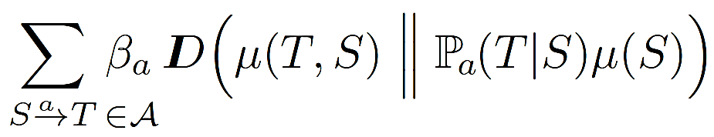
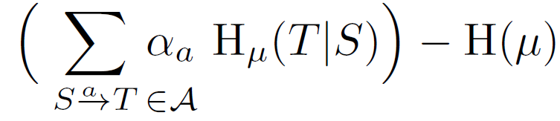


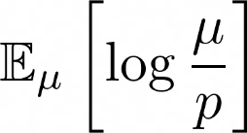
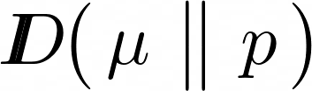








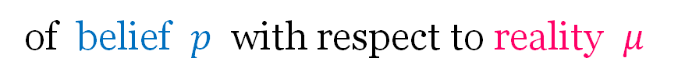
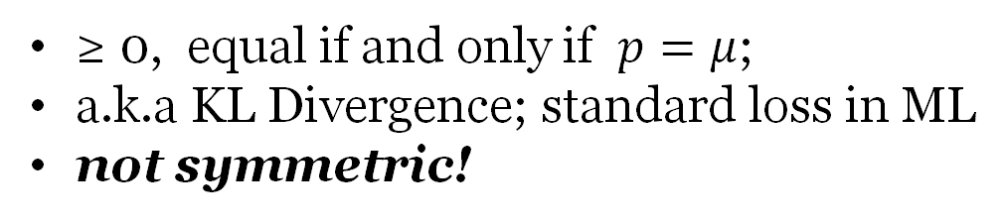
PDG Semantics
Importance of structure ($≥0$)
(joint dists)
Structural Incompatibility with $(𝒜,α)$
scoring function
Observational Incompatibility with (ℙ, β)
Relative Entropy
(just to be explicit)
Two aspects:
of belief $p$ with respect to reality $μ$
(set of) optimal distributions
=
Inconsistency
≥ 0, equal if and only if $p=μ$;
a.k.a KL Divergence; standard loss in ML
not symmetric!
the smallest possible incompatibility with any $μ$

Slide 8


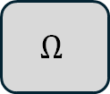



probability
$$P$$
outcomes
$$Ω$$
random
variables
$$A$$
$$C$$
$$B$$
A
C
B
event
$$a$$
?
Most consistent thing to put here: P(B|A)

Slide 9
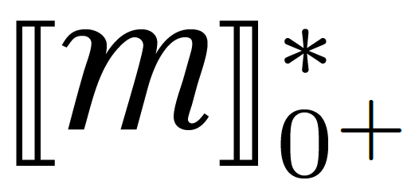
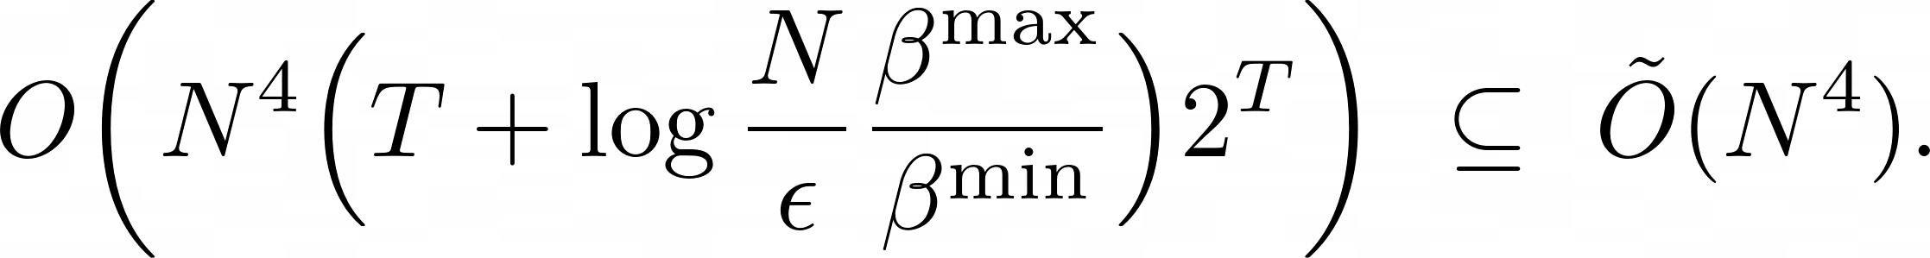

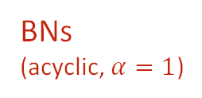
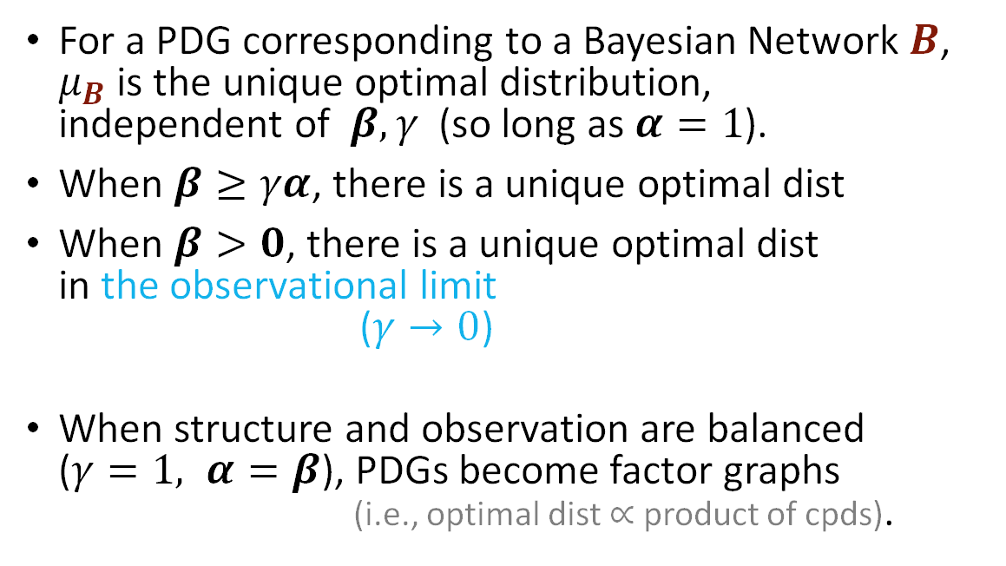

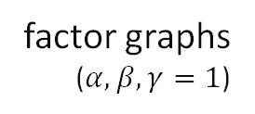

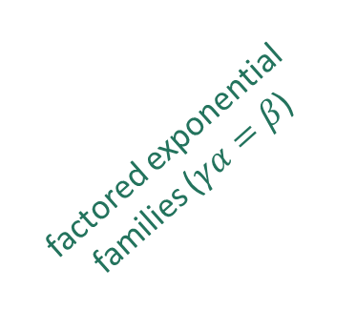

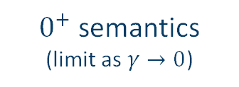
PDGs and other
Graphical Models
For a PDG corresponding to a Bayesian Network $B$, $μ_{B}$ is the unique optimal distribution,
independent of $β, γ$ (so long as $α=1$).
When $β≥γα$, there is a unique optimal dist
When $β>0$, there is a unique optimal dist
in the observational limit
($γ→0$)
When structure and observation are balanced
($γ=1, α=β$), PDGs become factor graphs
(i.e., optimal dist $∝$ product of cpds).
$0^{+}$ semantics
(limit as $γ→0$)
$$β$$
factor graphs
($α,β,γ=1$)
confidence in observation
BNs
(acyclic, $α=1$)
factored exponential families ($γα=β$)
PDGs capture BNs & FGs.
$$±γ$$
$$\text{confidence} \text{in} \text{structure}$$
$$γα$$

Slide 10



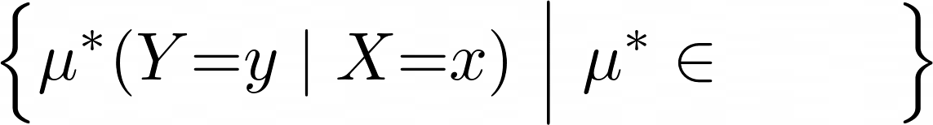
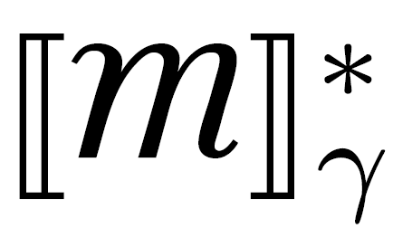
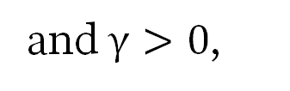
The Inference Problem for PDGs
“What is Pr(Y=y|X=x)?”
Given:
a PDG ,
variables
values
,
and $γ>0$,
Compute:
the conditional probability of y given x
in (all) optimal distribution(s)

Slide 11

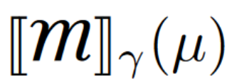


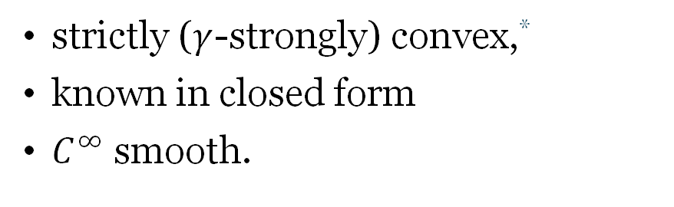




Why is this even hard?
*(provided $β≥γα$)
just have to find $μ$ that minimizes
strictly ($γ$-strongly) convex,*
known in closed form
$C^{∞}$ smooth.
:
,
a function that is…
Difficulties
D1. even writing down $μ$ takes exponential time
( let alone evaluating or minimizing it )
D2. these properties are not enough!
( is neither Lipshitz nor self-concordant)
D3. even if we can find optimizers , how do
we find the observational limit ?
🙈
🙈

Slide 12
Inference for PDGs
via
exponential conic programming

Slide 13


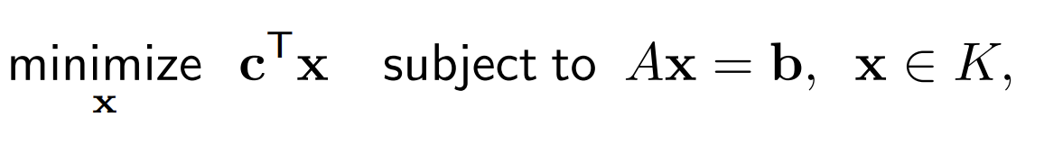

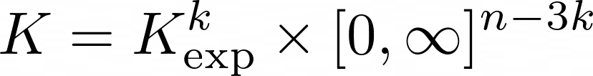
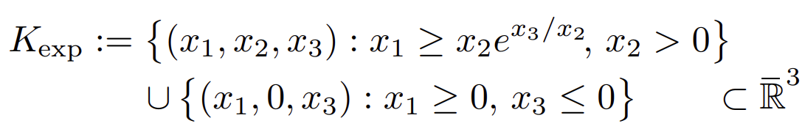
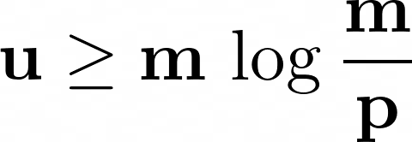


exponential conic programming
Non-symmetric cone, but can still be solved in polynomial time with interior point methods.
(positive orthants)
exponential cone
[ Nesterov, 1999. Infeasible-start primal-dual methods and infeasibility detectors for nonlinear programming problems. ]
or “relative entropy cone"

Slide 14
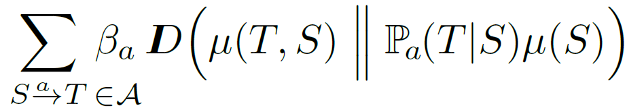

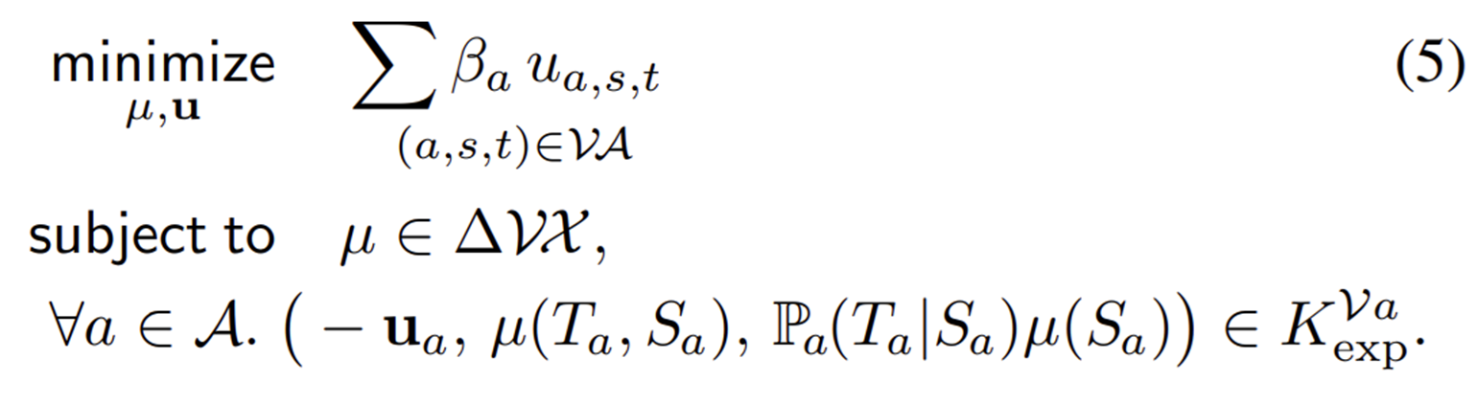
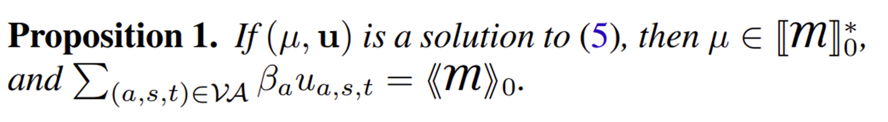
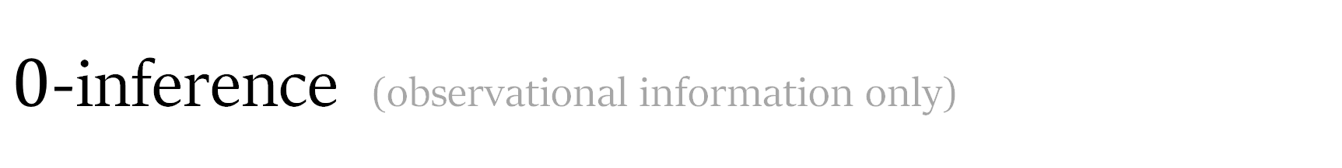
$0$-inference (observational information only)

Slide 15

$0$-inference (observational information only)

Slide 16
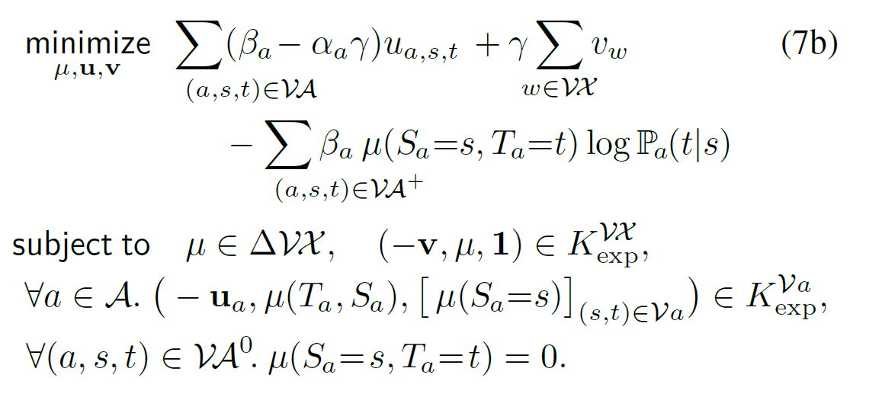

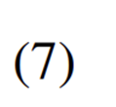


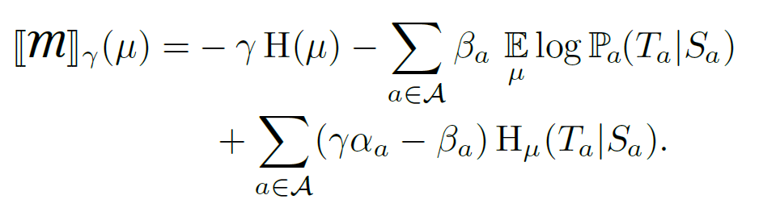
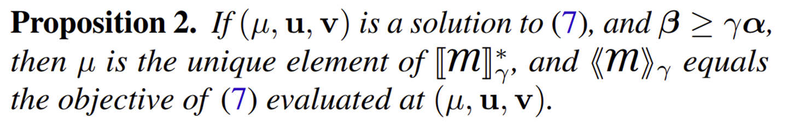
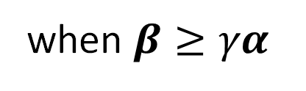
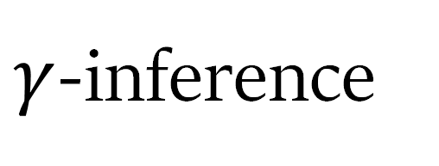
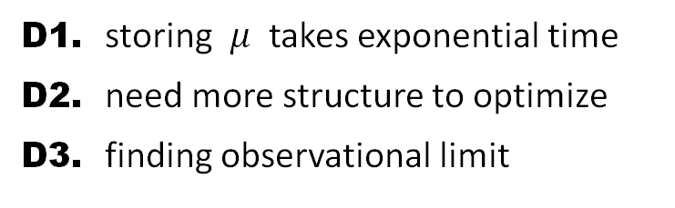
$γ$-inference
( difficulties )
D1. storing $μ$ takes exponential time
D2. need more structure to optimize
D3. finding observational limit
when $β≥γα$
Rewriting PDG
scoring function …

Slide 17
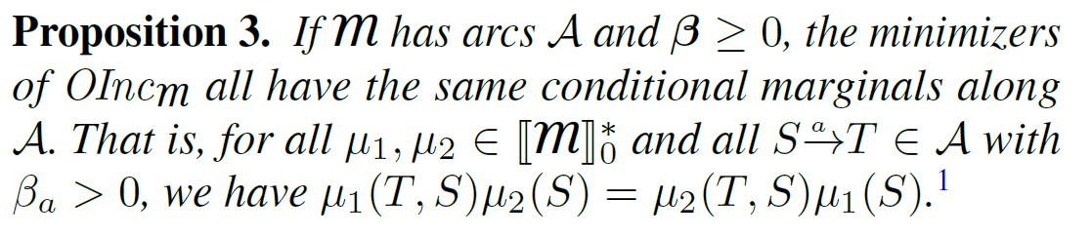









$0^{+}$-inference
Minimizers
of
… so it suffices to do 0-inference once to find a set of linear constraints characterizing .
Problem: is not at all convex...
… but its restriction to
is!
uniquely among them,
best minimizes
The Plan:
constrain to ,
then minimize .

Slide 18









$0^{+}$-inference
Find

Slide 19




( difficulties )
These optimization problems grow exponentially with the number of variables!
😬
D1. storing $μ$ takes exponential time
D2. need more structure to optimize
D3. finding observational limit
$$γ=0$$
$$γ≤\min_{a}\frac{β_{a}}{α_{a}}$$
$${γ→0}^{+}$$
Find

Slide 20


Tree Decompositions & Tree Marginals
A tree decomposition
of a hypergraph
is a tree
whose vertices
are subset of N, called “clusters”, such that:
each hyperedge is contained in some cluster,
the intersection of any two clusters is a subset of every cluster on the unique path (since it's a tree) between them
width of := size biggest cluster - 1;
treewidth of hypergraph := smallest possible width
of any tree decomposition
tw =1

Slide 21

Tree Decompositions & Tree Marginals
A tree decomposition
of a hypergraph
is a tree
whose vertices
are subset of N, called “clusters”, such that:
each hyperedge is contained in some cluster,
the intersection of any two clusters is a subset of every cluster on the unique path (since it's a tree) between them
2
width of := size biggest cluster - 1;
treewidth of hypergraph := smallest possible width
of any tree decomposition
Tree Marginal
a distribution over every cluster
tw =2

Slide 22




Polynomial Inference under Bounded Treewidth
A
B
C
D
P(A,B)
P(B,C)
P(C,D)
For PDGs, too, suffices to search over tree marginals ,
because PDGs have a similar independence property:
A
B
$$ℳ_{2 }$$
C
$$ℳ_{1 }$$

Slide 23




More Involved
Analogues…
$0$-inference
Cluster marginal matching constraints
P(A,B)
P(B,C)
B

Slide 24




More Involved
Analogues…
$γ$-inference (small $γ)$

Slide 25




More Involved
Analogues…
$0^{+}$-inference
Find

Slide 26



Compact inference using tree marginals!
Difficulties overcome!
D1. storing $μ$ takes exponential time
D2. need more structure to optimize
D3. finding observational limit
$$γ=0$$
$$γ≤\min_{a}\frac{β_{a}}{α_{a}}$$
$${γ→0}^{+}$$
Find

Slide 27











Overall: Inference for PDGs
?
When $β≥γα$,
$0^{+}$ semantics
(limit as $γ→0$)
can do inference and
$$β$$
calculate inconsistency
factor graphs
($α,β,γ=1$)
for a PDG that has
N arcs and vars
and treewidth T,
confidence in observation
BNs
(acyclic, $α=1$)
in
time.
factored exponential families ($γα=β$)
$$±γ$$
$$\text{confidence} \text{in} \text{structure}$$
$$γα$$

Slide 28




Implementation
connects Python PDG library to commercial solvers such as MOSEK and ECOS, via cvxpy.
http://github.com/orichardson/pdg
convex programming, via cvxpy
…
baselines, via pytorch
…

Slide 29

Results
this work
baselines
faster
more accurate

Slide 30



Results
(time)
(memory)
Inference on random PDGs with ~10 variables. The convex solver (gold, violet) is more accurate ($←$) than black-box optimization baselines (greens), and often faster ($↓$) for small PDGs. The area of each circle is proportional to the size of the optimization problem.

Slide 31


Slide 32

Results for BNs

Slide 33

( one small problem )
Given:
a PDG ,
variables
values
,
and $γ>0$,
Compute:
This may not be a rational number!
… so, we cannot compute it (in finite time)

Slide 34



Complexity of finding an Approximate Tree Marginal
$k$ bits for each probability and confidence
at most $N$ nodes & arcs, $V$ values per node, treewidth $T$
can find a tree marginal $ε$-close to $μ^{∗}$ in time
Our implementation: 4
Bayesian Networks: 1

Slide 35




Complexity of finding an Approximate Tree Marginal
approximate inference
need to…
request additional precision from oracle dynamically;
calculate something more stable than Pr(x,y) / Pr(x)
( probability of
the evidence X=x)

Slide 36
Reducing Inference to Inconsistency Measurement
Inconsistency Calculation
Exponential Conic Programming
PDG Inference

Slide 37








Expressing “$Pr⁡(Y$=$y)=p$” with a PDG
“this construction does the right thing.”
Lemma 22.
For every PDG
,
with equality iff
.
.
Lemma 23. The function $f(p)$ is strictly convex.

Slide 38


Slide 39






Algorithm: cvx “binary search”
Goal: find $p^{∗}≔argmin f∈[0,1]$ (to within $±ε$)
State: $(a,b,c)$
invariant: $p^{∗}∈[a,c]$
$$>$$
f(a)
f(z)
f(c)
f(b)
$$<$$
…
…
a
z
b
c

Slide 40













( a small problem )
$$>$$
How do we compare two real numbers?
If we compare bit-by-bit, will it ever terminate? (i.e., is it even a recursive procedure?)
How long will it take?
If
and
,
then
$$<$$
The numbers are not too close; can compare them quickly!
(requires 18 pages of math to prove; all months after the conference)

Slide 41


Slide 42
Inconsistency Calculation
Exponential Conic Programming
find a tree marginal, then evaluate the scoring function
PDG Inference

Slide 43


Summary
PDG inference is a very general problem
It is equivalent to calculating inconsistency;
Both can now be done in polynomial time (assuming bounded treewidth, which was the best we could hope for)
Thanks!
Inconsistency Calculation
Exponential Conic Programming
PDG Inference

